Slide 1
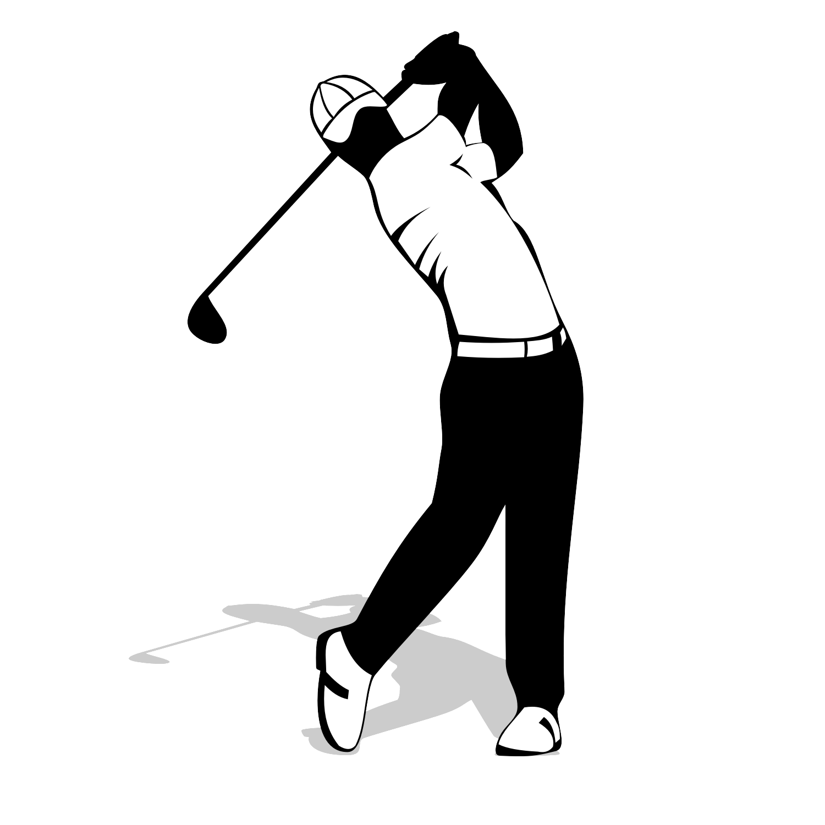
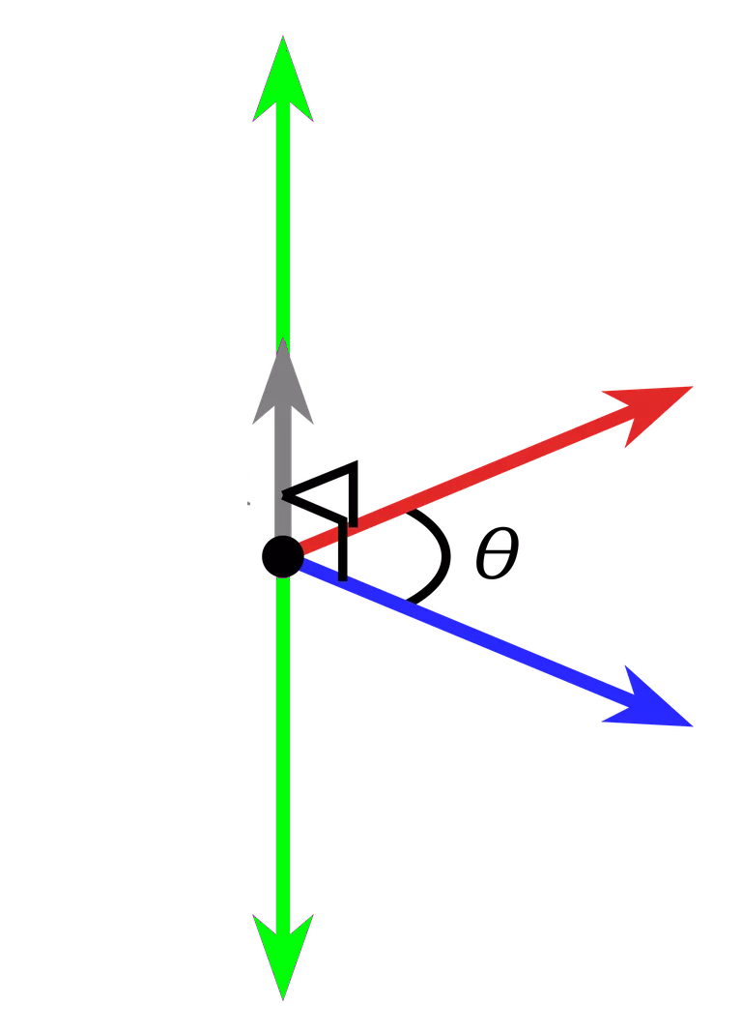

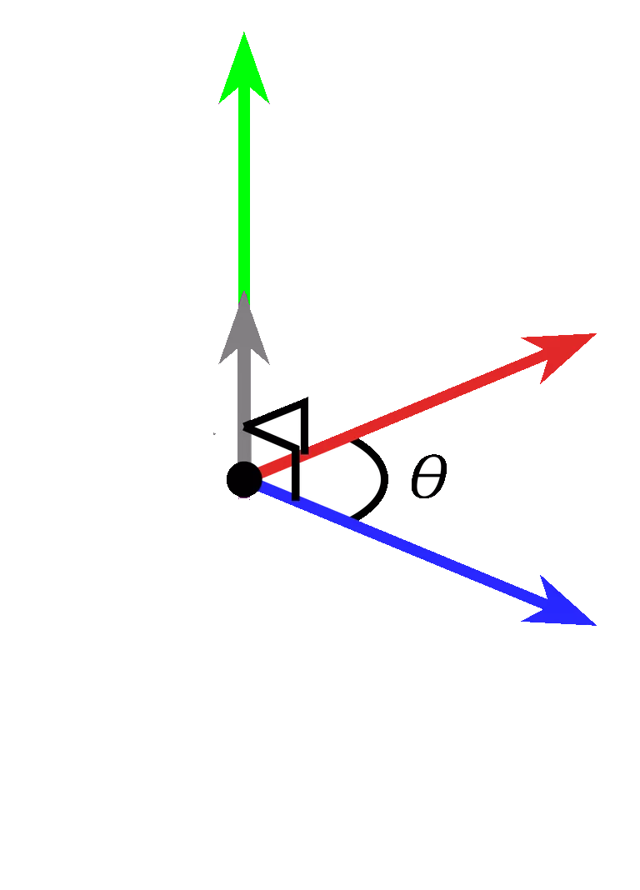
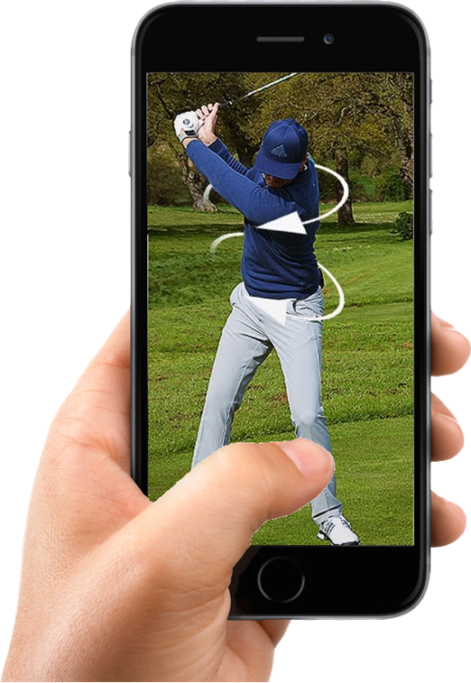
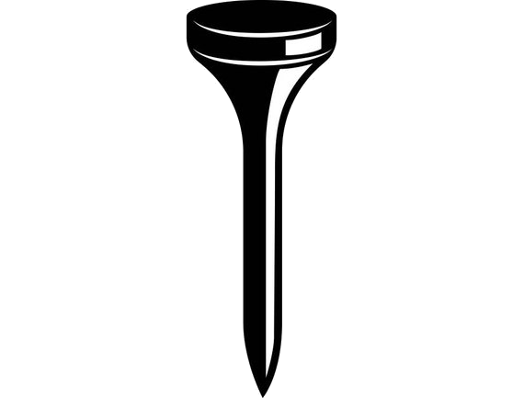
Golf Glove
Notes:
Cite yo shit

Slide 2
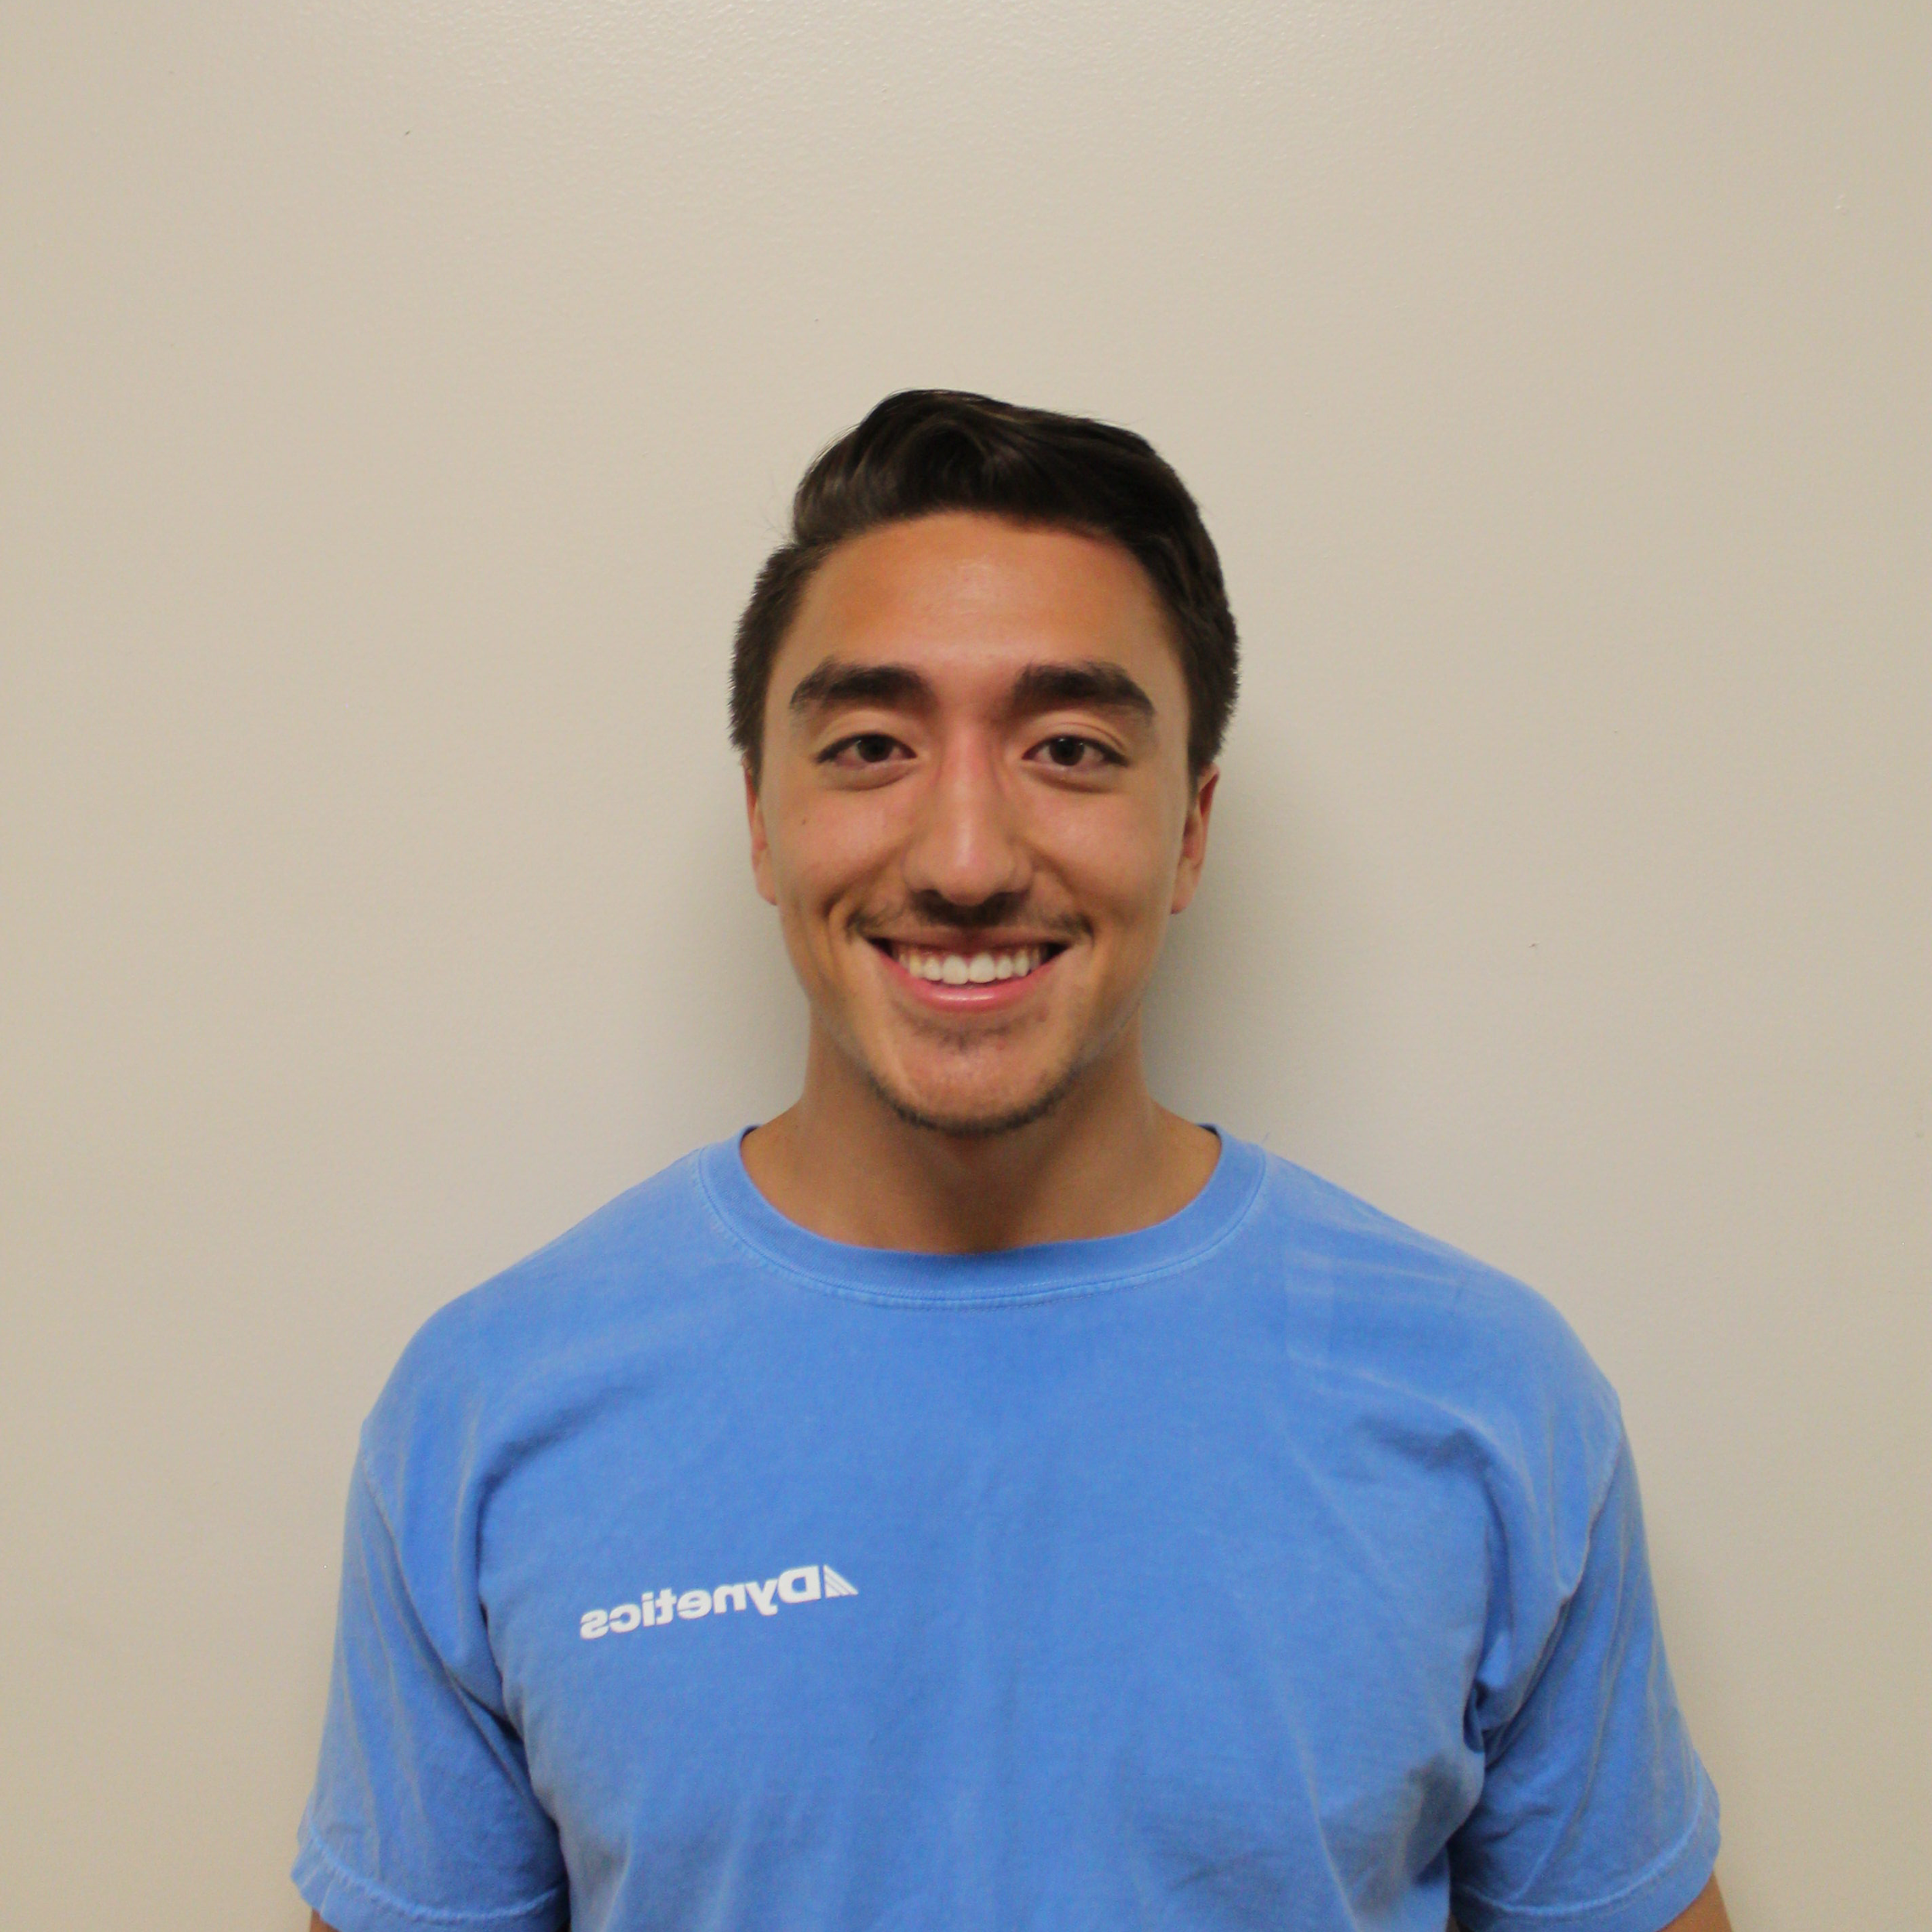
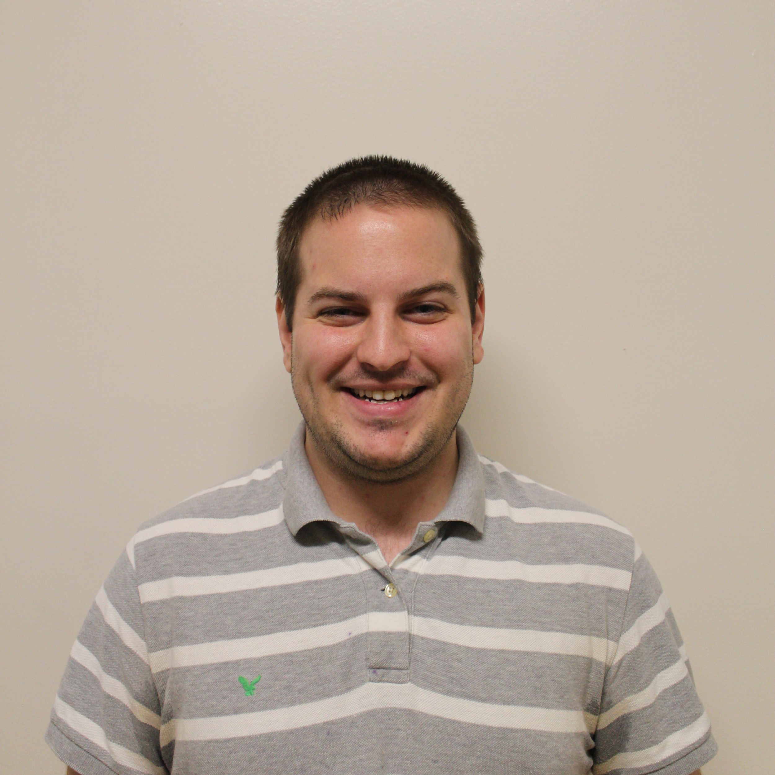
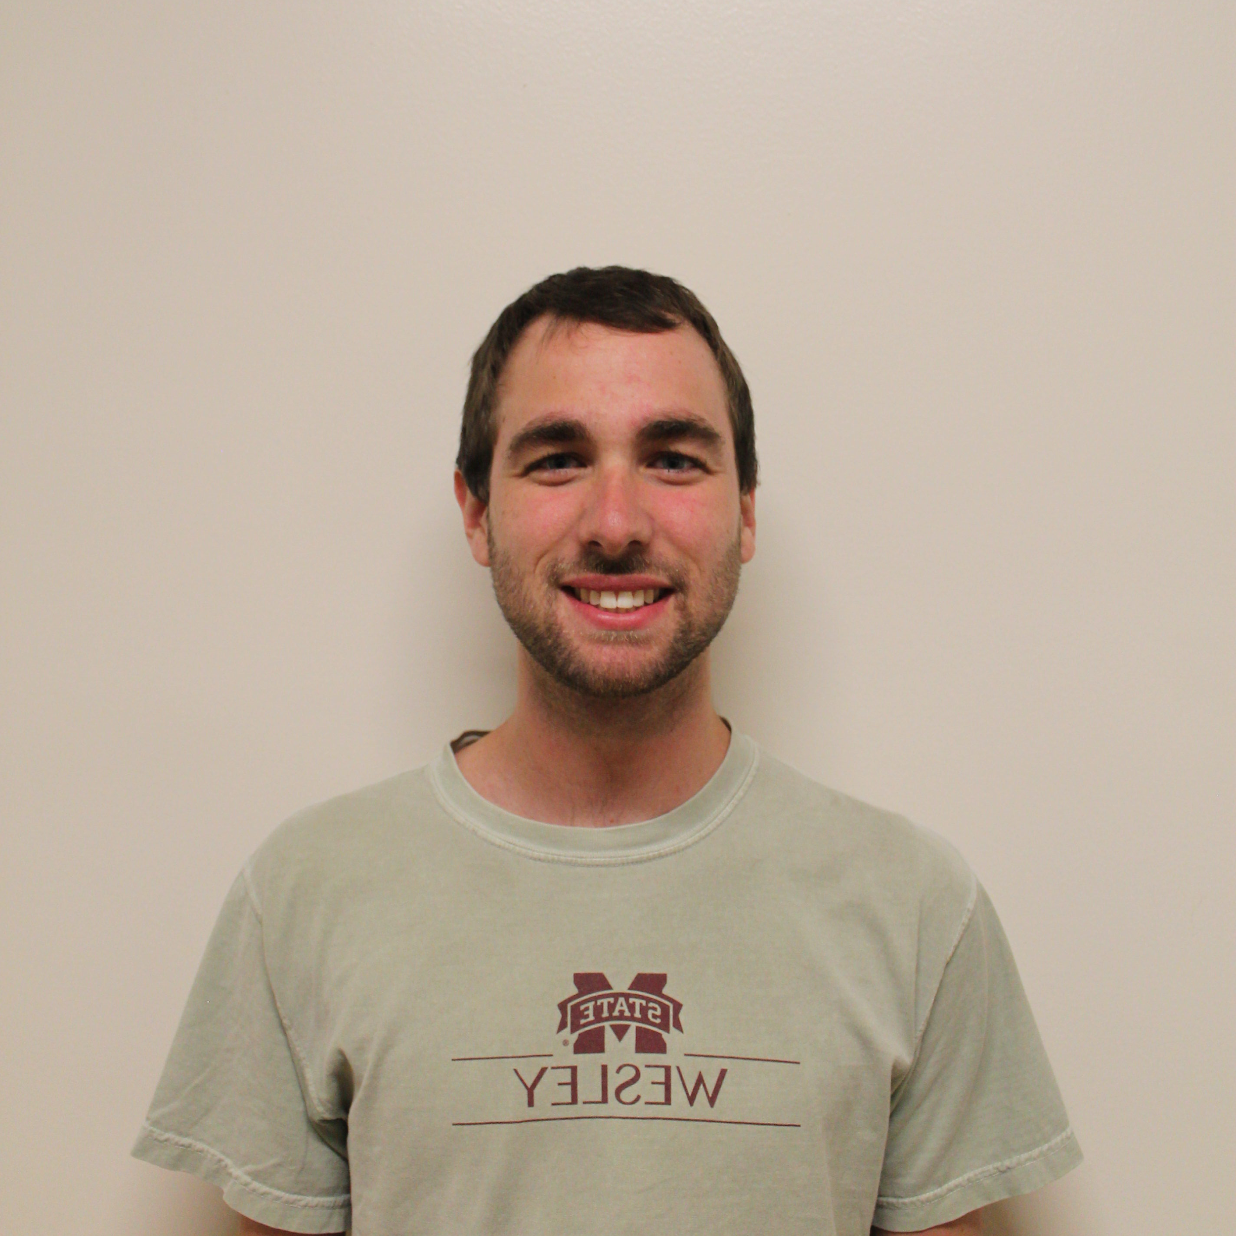
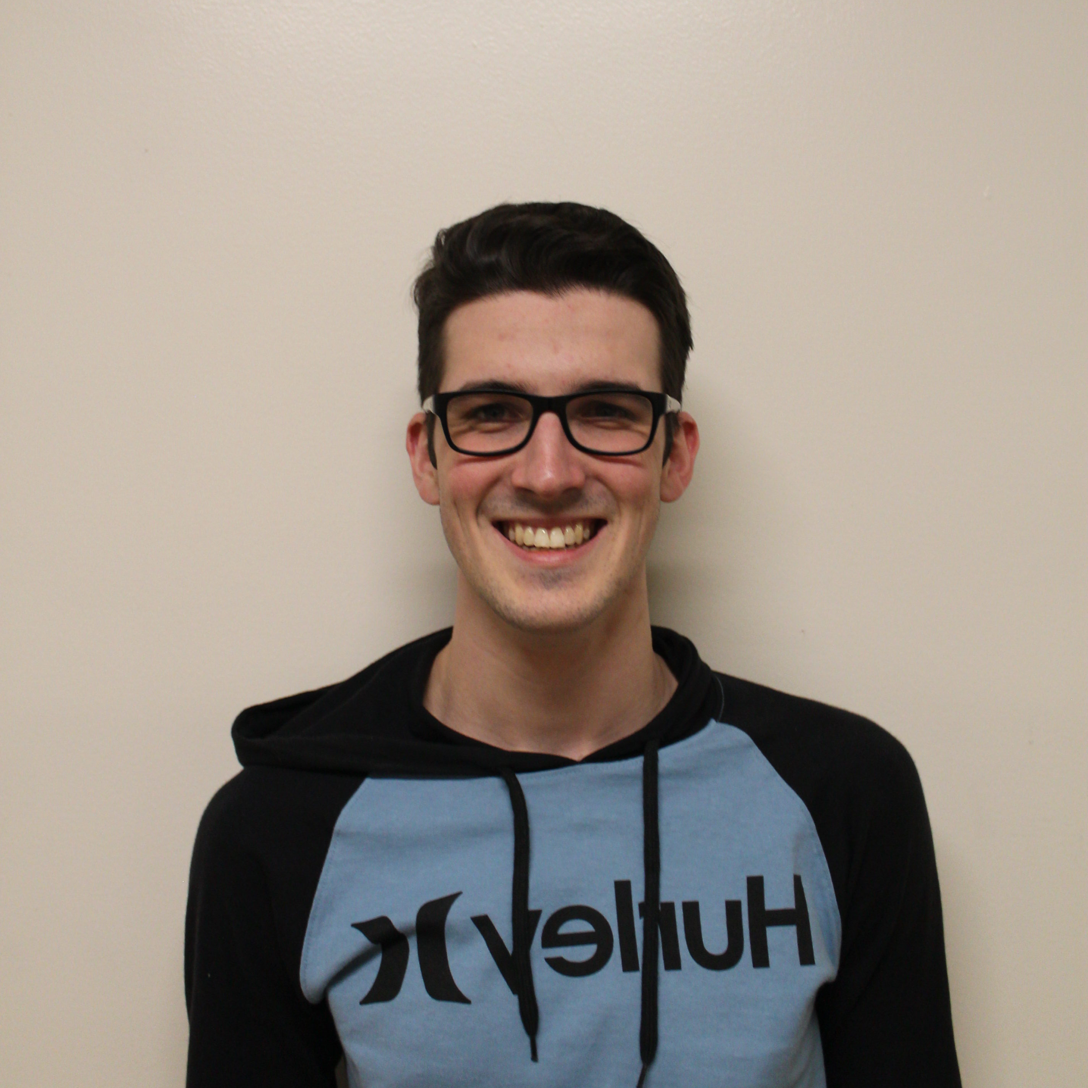
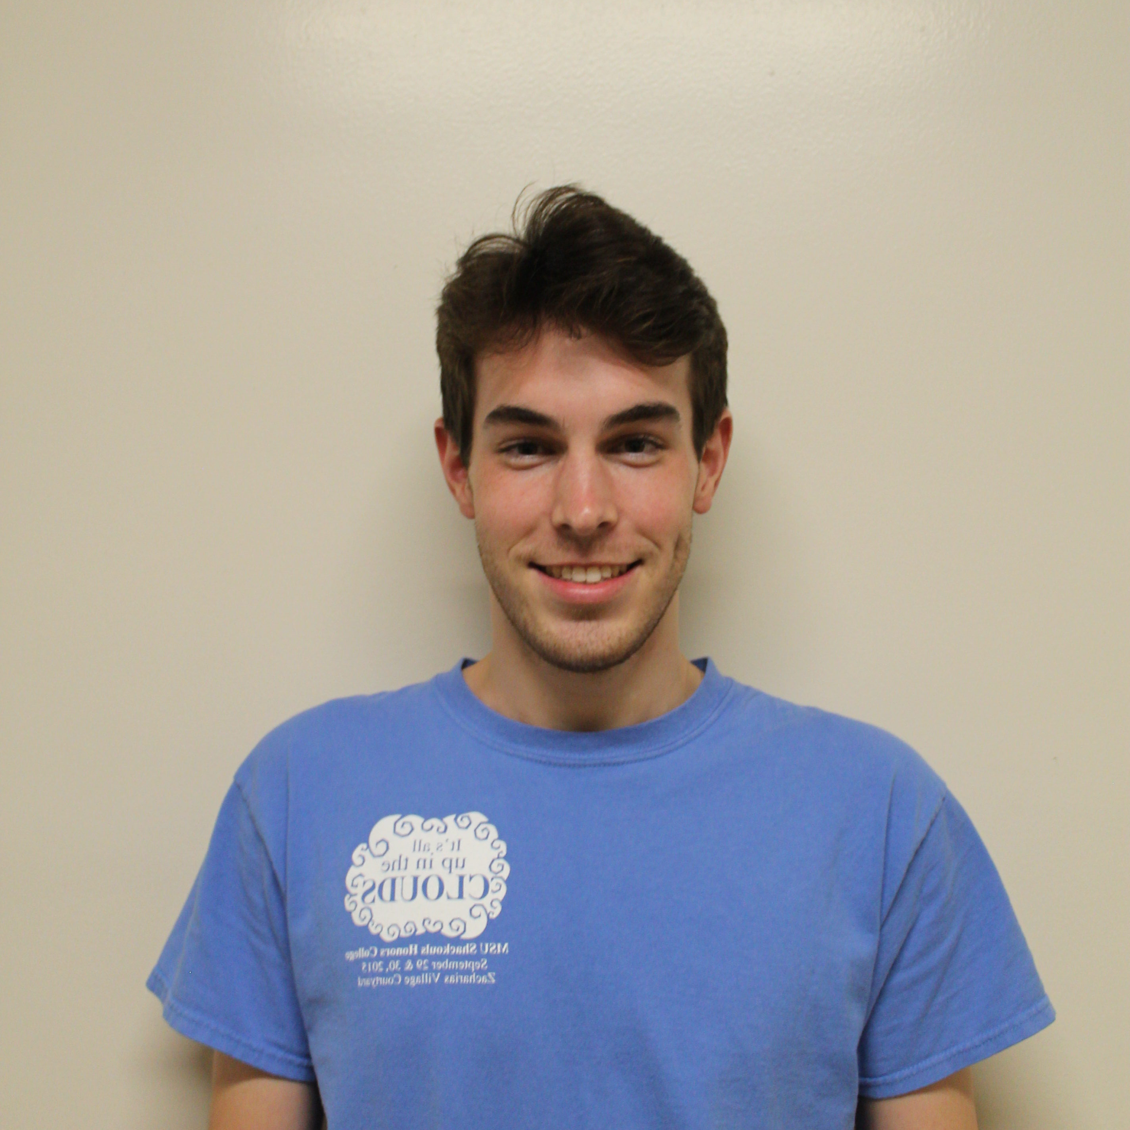
Team
Christian Bush
Computer Engineering
Software
Spencer Callicott
Computer Engineering
Firmware
Will Carroll
Computer Engineering Firmware
Landon Casey
Computer Engineering
Hardware
Jack Fletcher
Computer Engineering
Software
Notes:
Landon is the Man-don

Slide 3
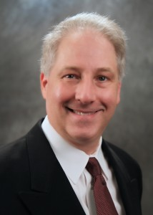
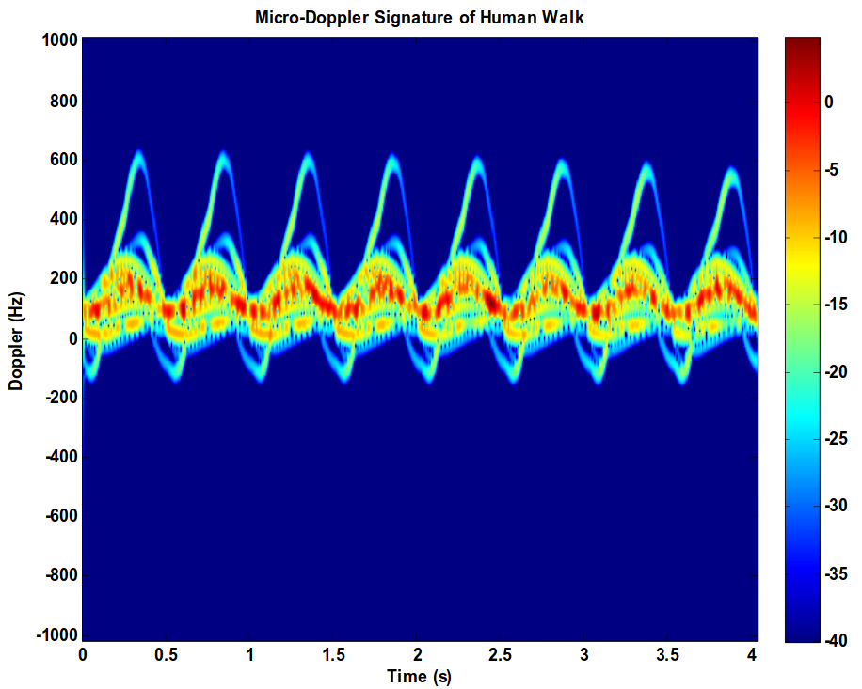
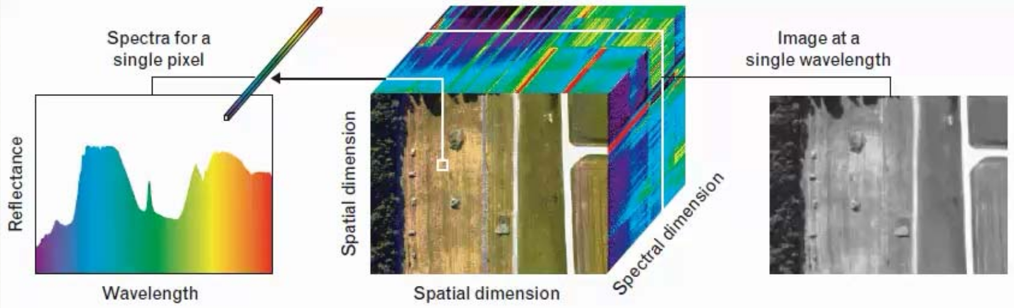
Advisor
Dr. John E. Ball
PhD, Electrical Engineering, Mississippi State University, 2007
MS, Electrical Engineering, Georgia Institute of Technology, 1993
Radar Systems
Digital Signal Processing
Digital Image Processing
Remote Sensing
Automated Target Detection
[1]
Notes:
Landon

Slide 4
Presentation Outline
Problem
Solution
System Overview
Constraints
Subsystem Testing
Integrated System Testing
Progress and Timeline
Notes:
Landon

Slide 5
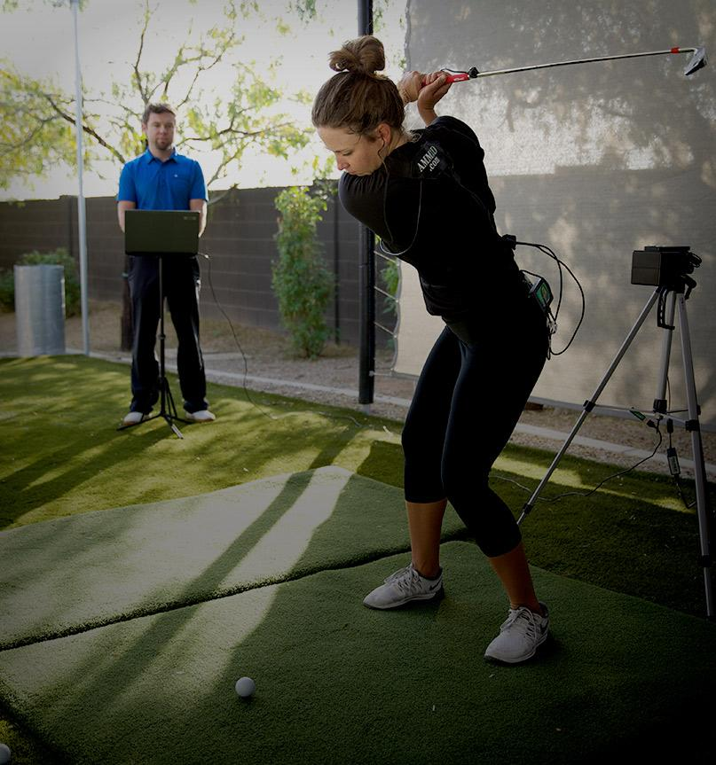
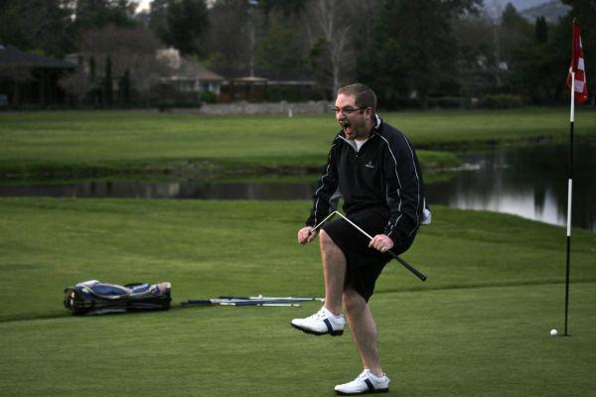
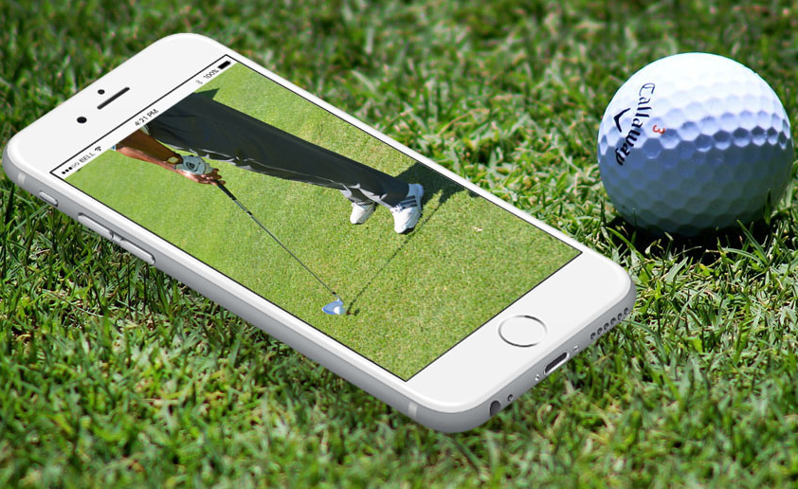
Problem Statement
Amateur Golf failures [2]
Next-generation coaching application [4]
Modern golf coaching technology [3]
Notes:
Landon
Golf has seen a recent upswing with millenials, who represent 36 percent of the nearly 24 million golfers in the United States. With 40.6 million Americans interested in golf, well over a third of that number “Around 15 million additional millennials expressed interest in taking up the game.” [x] -- https://www.cnbc.com/2017/08/12/millennials-breathing-new-life-into-golf-and-heres-how-the-industry-is-responding.html
Modern golf coaching often involves recording swings with high-speed cameras and accompanying accelerometer/position data. Performing analysis on this data is time consuming and requires a professional to be on-course reviewing the footage and giving tips.
Development has already started on the next generation of golf-swing coaching in the form of bluetooth position sensors paired with smartphone applications to give the user quick feedback based on comparing swing positioning to an ideal swing.
Golf Glove intends to build upon this approach by incorporating proprietary LiquidWire wearable stretch-sensors to measure wrist angles and correlate it with swing positioning data to provide the amateur golfer a high-resolution analysis of their swing technique.

Slide 6
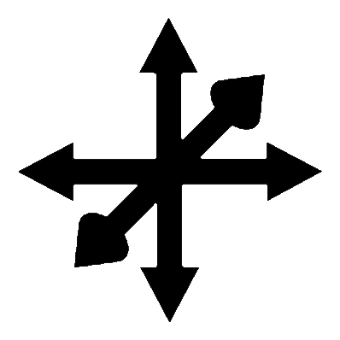
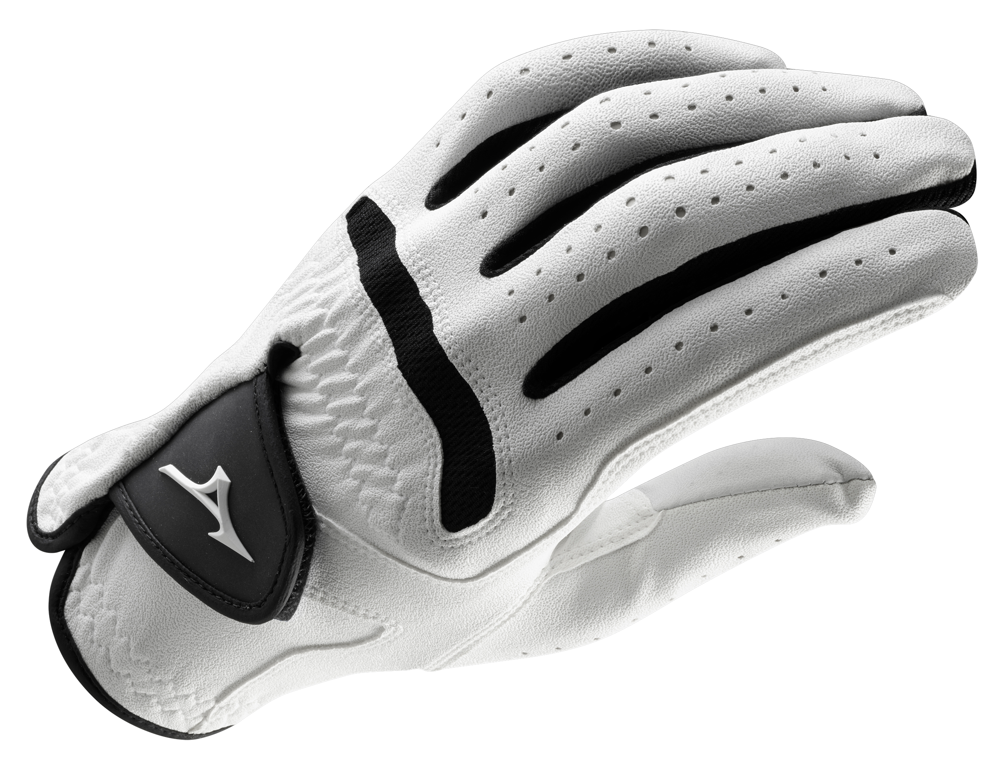
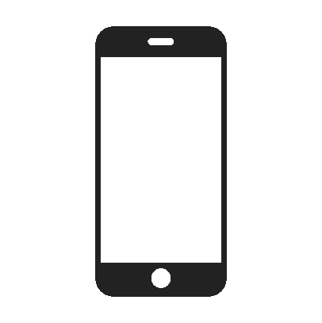

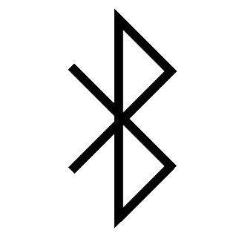

Solution
Accelerometer measures hand and club velocity through the swing
User friendly application to give intelligent swing feedback.
Gyroscopes track hand and club orientation through the swing.
BLE provides wireless transfer of coaching data.
On board battery allows for hours of runtime
Notes:
Landon
Our display must show the user’s wrist stretch and hand orientation, as well as allow the user to choose between “live” and “recorded” options.
The system must be portable: meaning no lengthy wires and powered by a battery.

Slide 7
Technical Constraints
Name | Description
Hand Orientation | The glove must determine the angles of wrist flexion, extension, and deviation within a 3° margin of error. Also, the glove must measure wrist acceleration, hand orientation, and hand acceleration within a 5% margin of error.
Wireless Communication | The wrist-mounted controller must communicate wirelessly with a range that will span the average width of a tee box: 30 feet.
Data Display | The system must communicate its measurements to a visual application that will display these metrics through a simple interface. The data can be analyzed after recording a swing, or real-time with both modes supporting a data rate of 100 hertz.
Unobtrusive | The user must not be obstructed while gripping the club with the glove on. The wrist-mounted computer must have a footprint smaller than the average sweat-band size of 3 inches. The sensor wires in the glove must not interfere with swing motion.
Portability | The wrist-mounted controller must be battery powered and not require manual calibration on start-up.
Notes:
Christian
Our display must show the user’s wrist stretch and hand orientation, as well as allow the user to choose between “live” and “recorded” options.
The system must be portable: meaning no lengthy wires and powered by a battery.

Slide 8
Practical Constraints
Name | Description
Manufacturability | The garment and controller must be modular and allow swapping if a subsystem fails.
Sustainability | The glove must have adequate battery life of at least 5 hours.
Notes:
Christian
Our display must show the user’s wrist stretch and hand orientation, as well as allow the user to choose between “live” and “recorded” options.
The system must be portable: meaning no lengthy wires and powered by a battery.

Slide 9
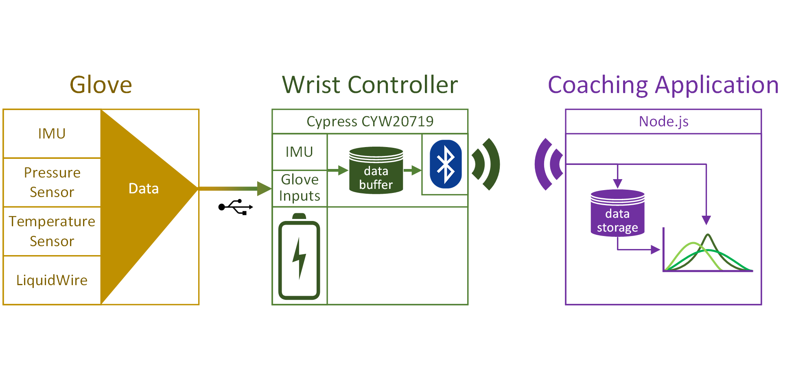
System Overview

Slide 10
Sensor Subsystem
Sensors
Accelerometer
Gyroscope
Pressure Sensor
Liquid Wire
Notes:
Spencer
Our display must show the user’s wrist stretch and hand orientation, as well as allow the user to choose between “live” and “recorded” options.
The system must be portable: meaning no lengthy wires and powered by a battery.

Slide 11
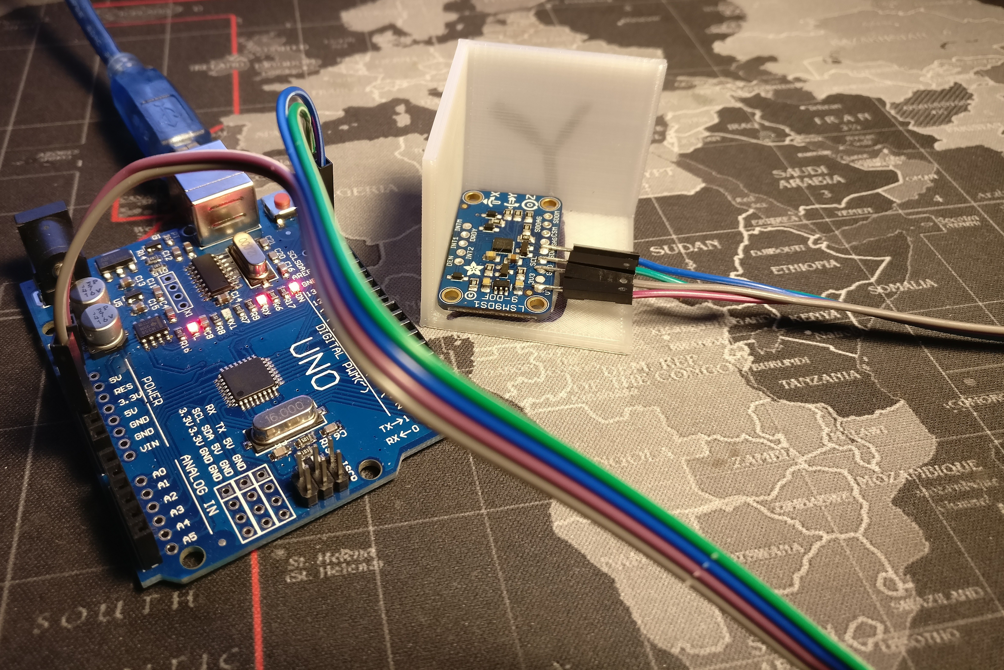
Sensor Subsystem - Accelerometer
Test | Xexp (m/s^2) | Yexp | Zexp | Xact | Yact | Zact
X-Axis | 9.8 | 0 | 0 | 10.050 | 0.106 | 0.374
Y-Axis | 0 | 9.8 | 0 | 0.167 | 9.786 | 0.894
Z-Axis | 0 | 0 | 9.8 | 0.668 | 0.159 | 10.135
Resting on each axis, measuring acceleration due to gravity.
Notes:
Spencer
Our display must show the user’s wrist stretch and hand orientation, as well as allow the user to choose between “live” and “recorded” options.
The system must be portable: meaning no lengthy wires and powered by a battery.

Slide 12
Sensor Subsystem - Gyroscope
90 degree movement around 46cm fulcrum (arm length) over 1 second
Test | Xexp (dps) | Yexp | Zexp | Xact | Yact | Zact
X-axis | 45 | 0 | 0 | 39.652 | 0.390 | 1.235
Y-axis | 0 | 45 | 0 | 6.701 | 40.124 | 15.413
Z-axis | 0 | 0 | 45 | 3.30425 | 0.515 | 39.053
Notes:
Spencer
Our display must show the user’s wrist stretch and hand orientation, as well as allow the user to choose between “live” and “recorded” options.
The system must be portable: meaning no lengthy wires and powered by a battery.

Slide 13
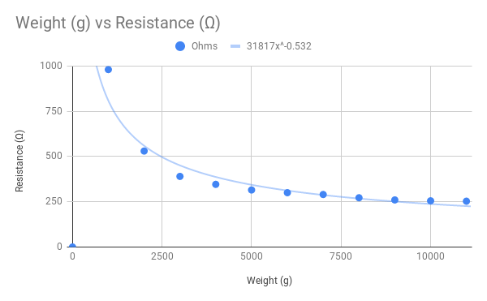
Sensor Subsystem - Pressure Sensor
Weight (g) | Measured (Ω)
0 | ∞
1000 | 980
2000 | 530
3000 | 390
4000 | 346
5000 | 315
6000 | 300
7000 | 290
8000 | 272
9000 | 260
10000 | 255
11000 | 253
Notes:
Landon
Our display must show the user’s wrist stretch and hand orientation, as well as allow the user to choose between “live” and “recorded” options.
The system must be portable: meaning no lengthy wires and powered by a battery.

Slide 14
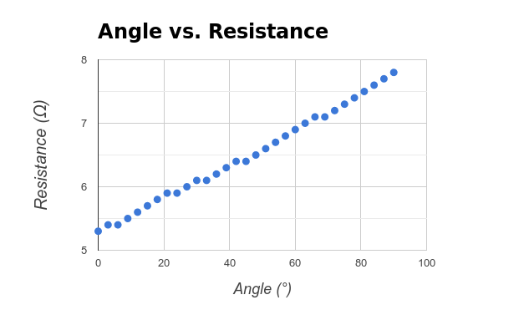
Sensor Subsystem - LiquidWire
Angle (°) | Resistance (Ω) | Angle (°) | Resistance (Ω)
0 | 5.3 | 48 | 6.5
3 | 5.4 | 51 | 6.6
6 | 5.4 | 54 | 6.7
9 | 5.5 | 57 | 6.8
12 | 5.6 | 60 | 6.9
15 | 5.7 | 63 | 7
18 | 5.8 | 66 | 7.1
21 | 5.9 | 69 | 7.1
24 | 5.9 | 72 | 7.2
27 | 6 | 75 | 7.3
30 | 6.1 | 78 | 7.4
33 | 6.1 | 81 | 7.5
36 | 6.2 | 84 | 7.6
39 | 6.3 | 87 | 7.7
42 | 6.4 | 90 | 7.8
45 | 6.4
ΔResistance (Ω) from 0° to 90° = 2.5 Ω
=> Angle (°) = 0.0278 x Resistance (Ω)
Notes:
Landon
Our display must show the user’s wrist stretch and hand orientation, as well as allow the user to choose between “live” and “recorded” options.
The system must be portable: meaning no lengthy wires and powered by a battery.

Slide 15
Wrist Controller Subsystem
Wrist-mounted Microcontroller
Battery
Sensor Polling
Bluetooth Broadcast
Notes:
Will
Our display must show the user’s wrist stretch and hand orientation, as well as allow the user to choose between “live” and “recorded” options.
The system must be portable: meaning no lengthy wires and powered by a battery.

Slide 16
Wrist Controller Subsystem - Sensor Polling
Throughput TODO:
Take accurate system time
Read sensors 120 times
Take accurate system time, measure difference
If System time difference < 1sec, we can attain at least a 120hz data rate.
Accuracy TODO:
Test accelerometer with same component test and compare output vs previous
Test gyroscope with same component test and compare output vs previous
Test pressure with same component test and compare output vs previous
Test stretch sensors with same component test and compare output vs previous
I2C and Voltage O-Scope Pictures
Notes:
Will
Our display must show the user’s wrist stretch and hand orientation, as well as allow the user to choose between “live” and “recorded” options.
The system must be portable: meaning no lengthy wires and powered by a battery.

Slide 17
Wrist Controller Subsystem - BLE Broadcast
[Scheduled]
1 Data Frame = 56 bytes
120 Hz * 56 bytes = 6.72 kB/sec = 53.76 kbps
BLE Rated Throughput = 2 Mbps
Notes:
Will
Our display must show the user’s wrist stretch and hand orientation, as well as allow the user to choose between “live” and “recorded” options.
The system must be portable: meaning no lengthy wires and powered by a battery.

Slide 18
Wrist Controller Subsystem - Battery
Overcharge/Discharge TODO
Notes:
Will
Our display must show the user’s wrist stretch and hand orientation, as well as allow the user to choose between “live” and “recorded” options.
The system must be portable: meaning no lengthy wires and powered by a battery.

Slide 19
Coaching App Subsystem
Bluetooth Reception
Database
GUI
Notes:
Jack
Testing of the coaching application includes the bluetooth reception, the database performance, and the graphics

Slide 20
Coaching App Subsystem - BLE Reception
Distance Test TODO
with rangefinder and open field (weather-permitting)
Accuracy TODO
Prove over series of data that the sent data matches received
Notes:
Jack
The Bluetooth reception testing will have two parts: distance and accuracy.
We planned to complete the distance test with a rangefinder in an open field but weather has delayed those plans these past couple days.
We will also test the accuracy of the connection to ensure the frontend is receiving all the frames that the wrist controller sends.

Slide 21
Coaching App Subsystem - Database
Database Throughput TODO
read and write speed > 120 Hz
Notes:
Jack
We also need to test the read and write performance of our database to ensure our read and writes can keep up with the 120 Hz sensor pollings.

Slide 22
Coaching App Subsystem - GUI
Throughput TODO
WebSocket packet bandwidth > 120 Hz
Notes:
Jack
Alongside the database testing, the coaching application needs to test the backend to frontend throughput. This is the speed that the database reads can be sent to the frontend via WebSockets. Our speed should exceed 120 Hz here too.

Slide 23
Integrated System
Full system battery endurance test TODO
Full system throughput test TODO
Full system hand/wrist orientation test TODO
Full system wrist speed test TODO
Notes:
Christian
Our display must show the user’s wrist stretch and hand orientation, as well as allow the user to choose between “live” and “recorded” options.
The system must be portable: meaning no lengthy wires and powered by a battery.

Slide 24
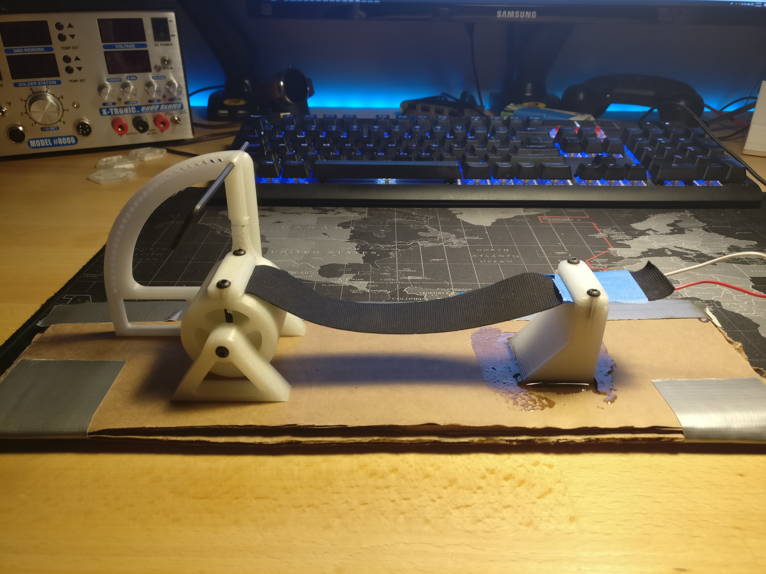
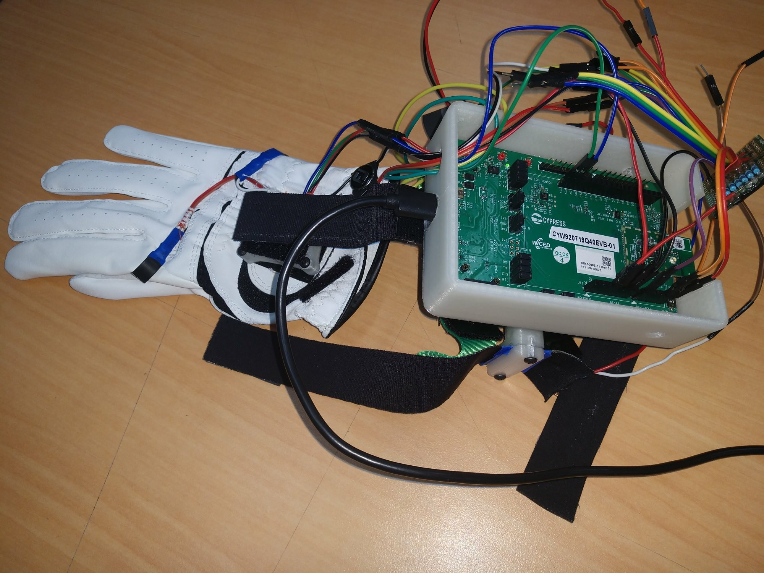



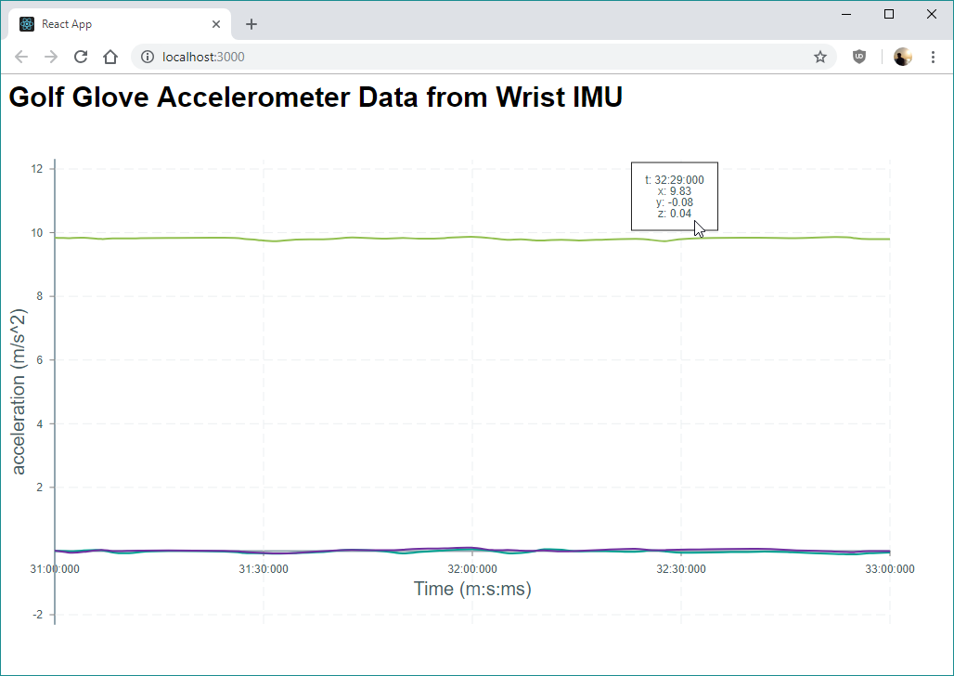
Progress
Sensors
Mount LiquidWire, Pressure, IMU
Sensor Unit Testing
I2C Communication with IMU
Wrist-mounted Microcontroller
BLE Broadcast
Threading Data Process/Send
Coaching Application
BLE Reception
Backend ⇔ Frontend Communication
Live Data Display
Notes:
Christian

Slide 25
Timeline
Sprint 1
Sprint 2
Sprint 3
Sprint 4
Sprint 5
Oct. 30th
Dec. 4th
Project Setup
Partial Subsystem Integration
Complete System Integration
Improvement
Constraint Qualifying Tests
Notes:
Christian
Sprint 1: Independent subsystems establish the function mimicking any required integration.
Sprint 2: Integration of the microcontroller and the glove itself. Integration of the coaching application backend to frontend.
Sprint 3: Fully integrate the Golf Glove system. Data was polled by the microcontroller and displayed on the frontend.
Sprint 4: Improve quality of data sampled. Store data. Improve the display.
Sprint 5: Completely test all the design constraints.

Slide 26
References
[1] Introduction to DSP (2018). https://mycourses.msstate.edu/bbcswebdav/pid-1559018-dt-content-rid-26818521_1/courses/jeb234.201830.Group01/Module_1.1_Introduction_Student.pdf [online].
[2] Ebaums World (2018). http://cdn.ebaumsworld.com/mediaFiles/picture/604025/84404810.jpg. [image].
[3] Exos (2018). https://www.teamexos.com/wp-content/uploads/2016/10/Hero_Capabilities_Golf.jpg. [image].
[4] Anadea (2018). https://anadea.info/uploads/image_attachment/image/1123/xCoaching_app.jpg.pagespeed.ic.eLjZbd84p6.jpg [image].

Slide 27
System Overview
Notes:
Showing overview again while questions are asked.

